Slide 1

Amazon Sales Analytics Dashboard
Data Analysis & Visualization using Power BI
PRESENTED BY:
Youssef Kamal
Maryam Nabil
Karten Wageh

Slide 2
Table of Contents
Exploratory Data Analysis (EDA)
1
Project Overview
5
Dashboard Showcase
2
Data Overview
6
Insights & Recommendations
3
Data Cleaning
7
4
Data Modeling

Slide 3

Project Overview
Objective:
To develop an interactive Power BI dashboard that analyzes Amazon product performance over a one-month period.
The goal is to move beyond simple reporting to provide actionable intelligence on Sales Velocity and Revenue Drivers.
Scope:
Overview: Monitoring Total Sales, Units Sold, and Average Ratings.
Drivers Analysis: Evaluating the impact of marketing levers like Coupons, Discounts, and Sponsored Ads.
Product Deep Dive: Providing the ability to drill down from a category level to a specific Product Deep Dive.

Slide 4

Data Overview
Data Source:
The dataset comprises transactional records for Amazon products, capturing the flow of sales, pricing, and customer feedback.
Key Attributes:
Metrics: Sales Amount, Units Sold, Current Price, Rating, Review Count.
Status Flags:
Is_In_Coupon: Boolean flag for active vouchers.
Is_Sponsored: Boolean flag for paid advertisement slots.
Is_In_Buy_Box: Boolean flag indicating if the seller won the primary "Add to Cart" button.

Slide 5
Data Cleaning
Column Optimization
Duplicate Removal
Data Typing
Null Handling

Slide 6
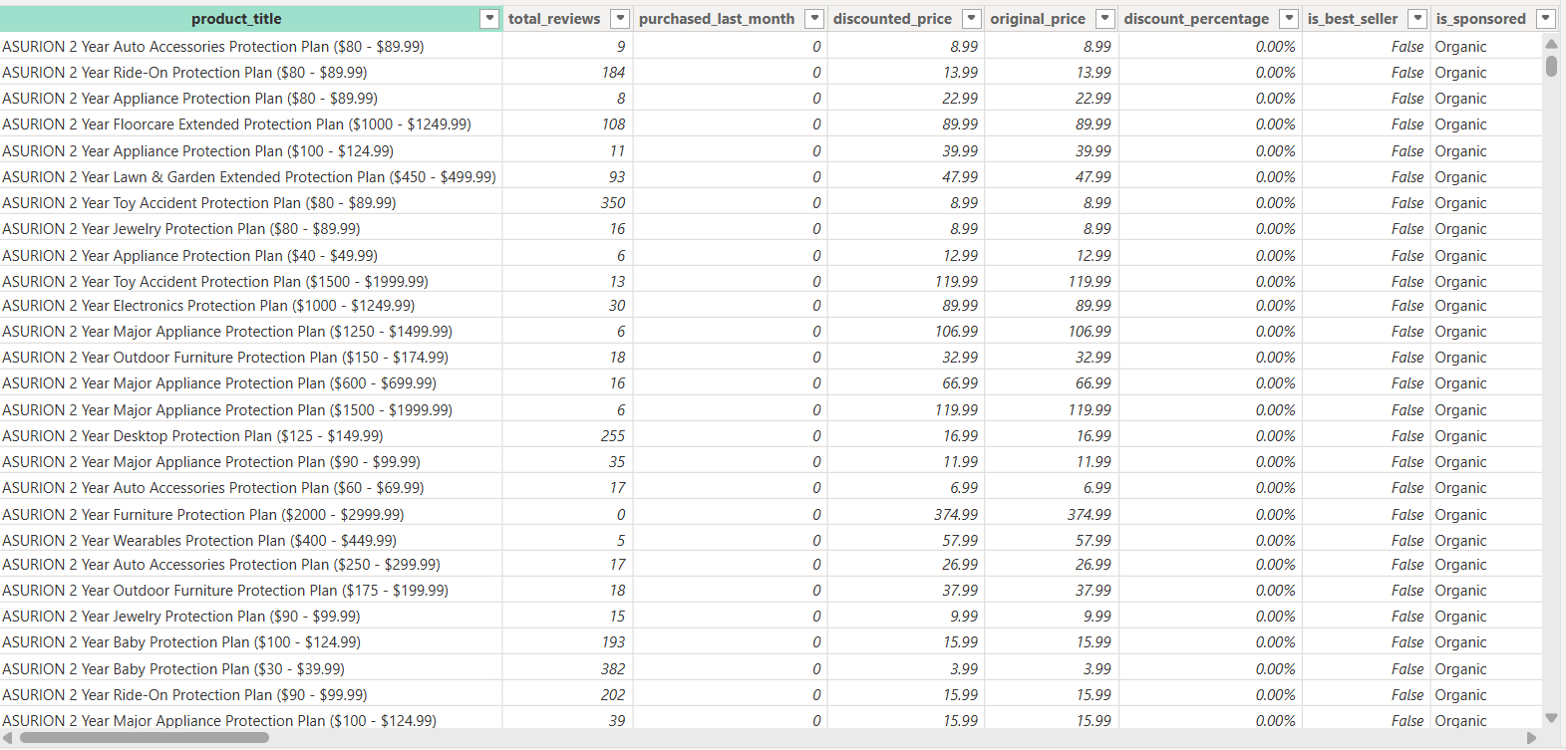
Data Cleaning

Slide 7
Data Modeling
Schema Architecture:
Table Roles:
Relationship Logic:
Star Schema: Optimized for performance.
Fact Table: FactAmazon (Transactions & Metrics).
Dimensions:
DimDate (Time Intelligence).
DimCategory (Product Filtering).
Established One-to-Many (1:*) relationships flowing from Dimension tables to the Fact table.

Slide 8
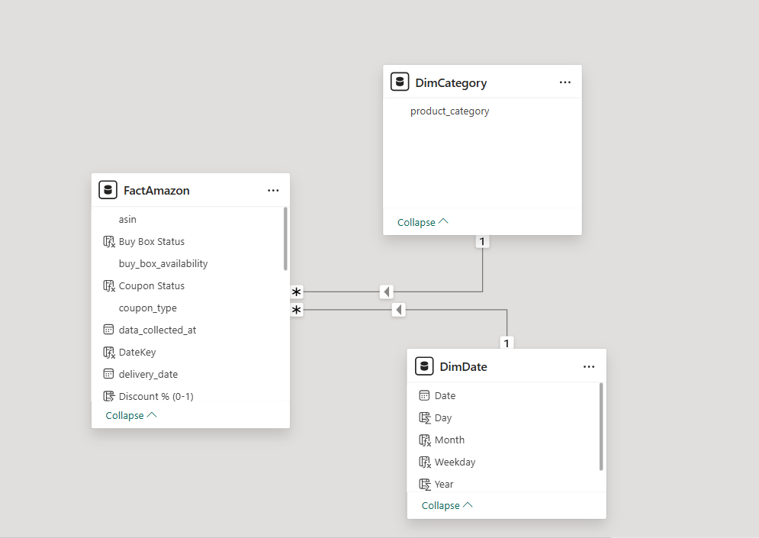
Data Modeling

Slide 9


Exploratory Data Analysis (EDA)
Discounts:
Coupons:
Positive correlation between Discount % and Units Sold.
Products with coupons sold less than those without.
Sponsored:
Buy Box:
Products with Buy Box had much higher sales than those without.
Sponsored items under-performed; most sales came from organic products.

Slide 10
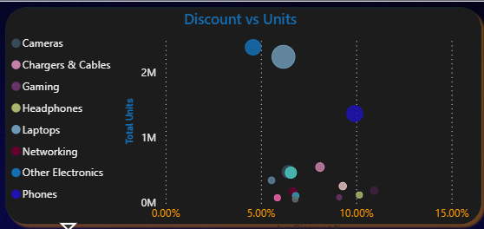
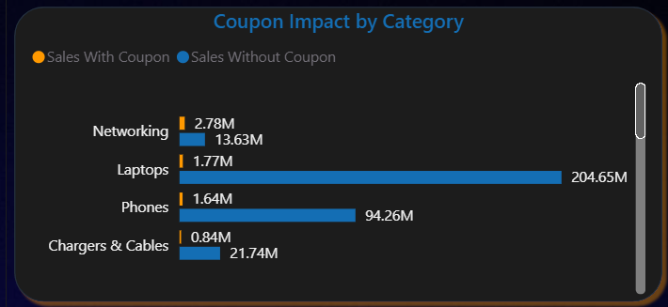
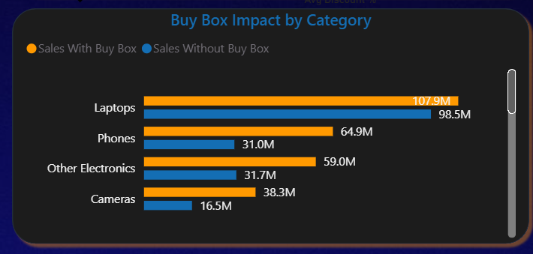
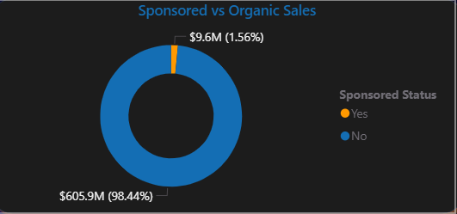
Exploratory Data Analysis (EDA)

Slide 11
Dashboard Showcase
Pages:
Product Deep Dive
Overview
Drivers
Focus: High-level business health.
Visuals: KPI Cards, Daily Trend Line, Top 10 Products table.
Focus: Impact of marketing levers.
Visuals: Scatter Plot (Discount vs. Units), Coupon Impact, Buy Box Share.
Focus: Specific item details.
Visuals: Product Image, Real-time Price, Rating (accessed via Drill-through).

Slide 12
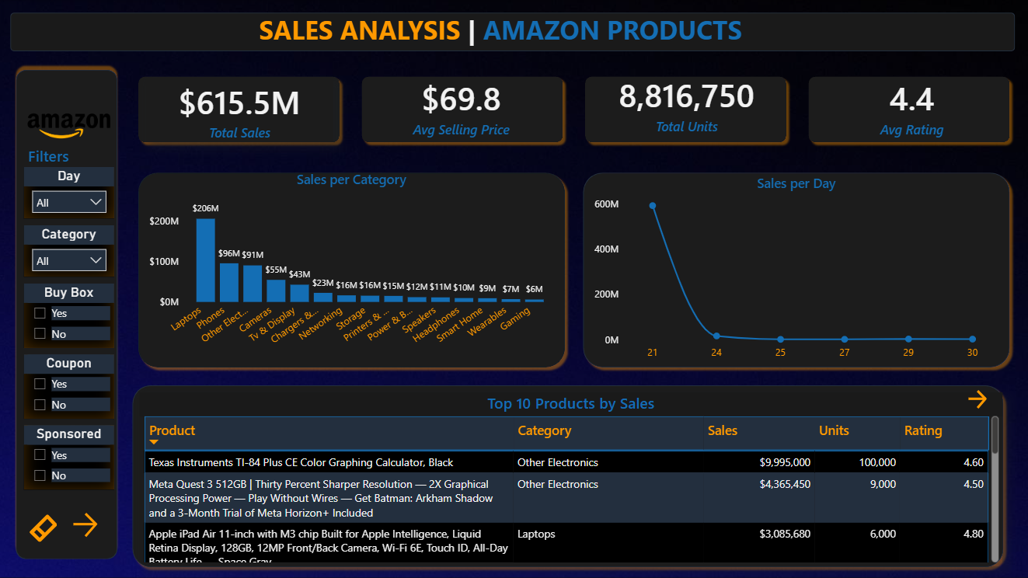
Dashboard Showcase: Page 1(Overview)

Slide 13
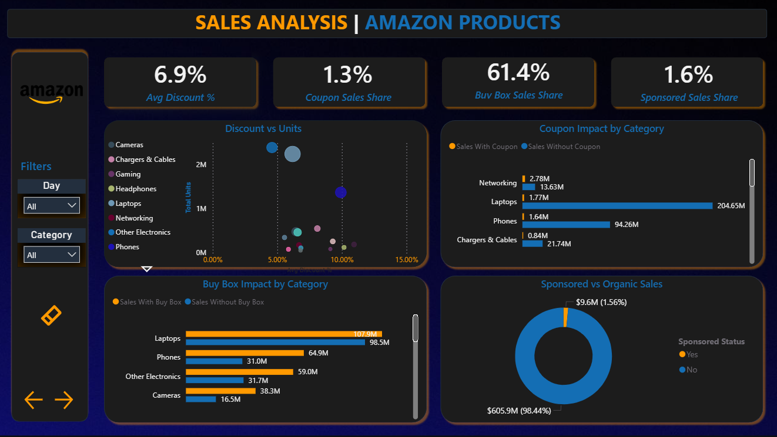
Dashboard Showcase: Page 2(Drivers)

Slide 14
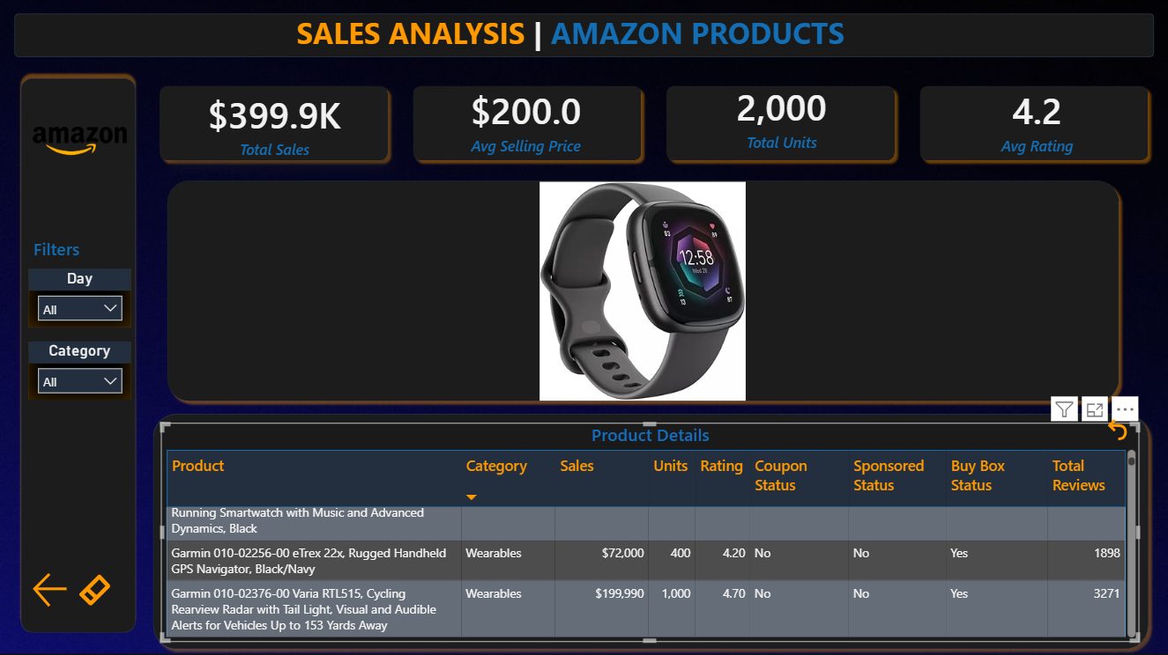
Dashboard Showcase: Page 3(Product Deep Dive)

Slide 15
Insights & Recommendations
Business Insights:
Buy Box: Winning the Buy Box is the primary driver for volume.
Ratings & Social Proof: Top-selling products consistently have high ratings (≈4★+) and many reviews, which means trust and perceived quality drive sales more than aggressive discounting.
Recommendations:
Focus on High-Rated Products: Prioritize stock and ad spend on products with strong ratings and review volume; avoid pushing low-rated items.
Protect the Buy Box: Keep prices competitive and inventory healthy to stay Buy Box–eligible on key products.
Targeted Promotions: Use discounts and Sponsored campaigns selectively (e.g., for new or high-potential products) instead of running blanket coupons on everything.
ns.

Slide 16

Thank You

